Slide 1

Operating Systems Design​ Session 34: Shared Memory Interprocess communication
19CS2106R​
© 2020 KL University

Slide 2
Shared Memory
Normally, the Unix kernel prohibits one process from accessing (reading, writing) memory belonging to another process
Sometimes, however, this restriction is inconvenient
At such times, System V IPC Shared Memory can be created to specifically allow on process to read and/or write to memory created by another process
Efficiency:
unlike message queues and pipes, which copy data from the process into memory within the kernel, shared memory is directly accessed
Shared memory resides in the user process memory, and is then shared among other processes

Slide 3
Disadvantages of Shared Memory
No automatic synchronization as in pipes or message queues (you have to provide any synchronization). Synchronize with semaphores or signals.
You must remember that pointers are only valid within a given process. Thus, pointer offsets cannot be assumed to be valid across inter-process boundaries. This complicates the sharing of linked lists or binary trees.

Slide 4
Shared Memory
Sharing the part of virtual memory and reading to and writing from it, is another way for the processes to communicate. The system calls are:
shmget creates a new region of shared memory or returns an existing one.
shmat logically attaches a region to the virtual address space of a process.
shmdt logically detaches a region.
shmctl manipulates the parameters associated with the region.

Slide 5
Shared Memory
Allows multiple processes to share a region of memory
Fastest form of IPC: no need of data copying between client & server
If a shared memory segment is attached
It become a part of a process data space, and shared among multiple processes
Readers and writers may use semaphore to
synchronize access to a shared memory segment

Slide 6
Shared Memory Segment Structure
Each shared memory has a structure
struct shmid_ds {
struct ipc_perm shm_perm;
struct anon_map *shm_amp; /* pointer in kernel */
int shm_segsz; /* size of segment in bytes */
ushort shm_lkcnt; /* # of times segment is being locked */
pid_t shm_lpid; /* pid of last shmop() */
pid_t shm_cpid; /* pid of creator */
ulong shm_nattch; /* # of current attaches */
ulong shm_cnattch; /* used only for shminfo() */
time_t shm_atime; /* last-attach time */
time_t shm_dtime; /* last-detach time */
time_t shm_ctime; /* last-change time */
};
We can get the structure using shmctl() function.
Actually, however, we don’t need to know the structure in detail.

Slide 7
shmget()
#include <sys/types.h>
#include <sys/ipc.h>
#include <sys/shm.h>
int shmget(key_t key, int size, int flag);
Returns: shared memory ID if OK, -1 on error
Obtain a shared memory identifier
size: is the size of the shared memory segment
flag: ipc_perm.mode
Example
shmId = shmget(key, size, PERM|IPC_CREAT|IPC_EXCL|0666);

Slide 8
Syntax for shmget:
shmid = shmget(key, size, flag);
where size is the number of bytes in the region. If the region is to be created, allocreg is used. It sets a flag in the shared memory table to indicate that the memory is not allocated to the region. The memory is allocated only when the region gets attached. A flag is set in the region table which indicates that the region should not be freed when the last process referencing it, exits. The data structure are shown below:

Slide 9
shmat()
#include <sys/types.h>
#include <sys/ipc.h>
#include <sys/shm.h>
void *shmat (int shmid, void *addr, int flag);
Returns: pointer to shared memory segment if OK, -1 on error
Attached a shared memory to an address
flag = SHM_RDONLY: the segment is read-only
addr==0: at the first address selected by the kernel (recommended!)
addr!=0: at the address given by addr

Slide 10
Memory Layout
high address
command-line arguments
and environment variables
stack
heap
0xf7fffb2c
shared memory
0xf77e86a0
0xf77d0000
0x0003d2c8
0x00024c28
malloc of 100,000 bytes
uninitialized data
(bss)
0x0003d2c8
0x00024c28
array[] of 40,000 bytes
initialized data
low address
text

Slide 11
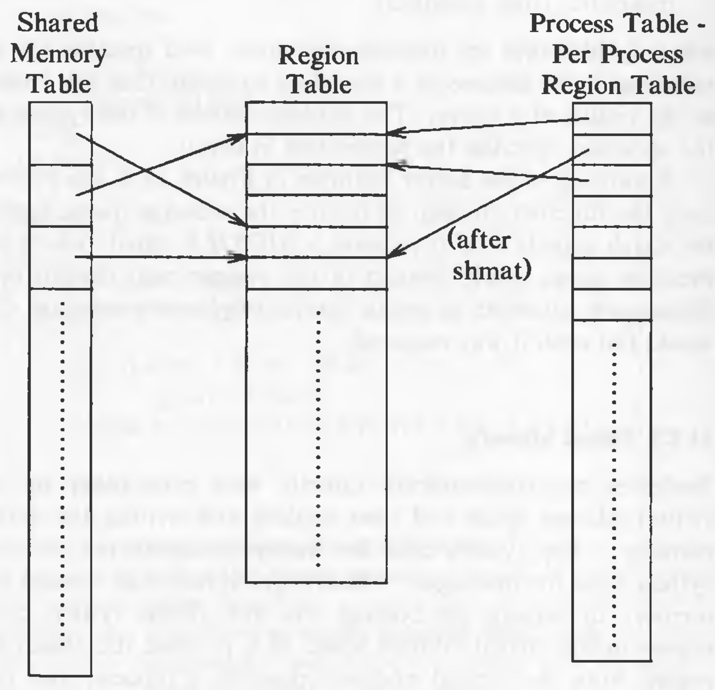
Data Structures for Shared Memory

Slide 12
Algorithm: shmat
/* Algorithm: shmat
* Input: shared memory descriptor
* virtual addresses to attach memory
* flags
* Output: virtual address where memory was attached
*/
{ check validity of descriptor, permissions;
if (user specified virtual address)
{
round off virtual address, as specified by flags;
check legality of virtual address, size of region;
}
else // user wants kernel to find good address
kernel picks virtual address: error if none available;
attach region to process address space (algorithm: attachreg);
if (region being attached for first time)
allocate page tables, memory for region (algorithm: growreg);
return (virtual address where attached);
}
If the address where the region is to be attached is given as 0, the kernel chooses a convenient virtual address. If the calling process is the first process to attach that region, it means that page tables and memory are not allocated for that region, therefore, the kernel allocated both using growreg.

Slide 13
The syntax for shmdt:
shmdt(addr);
where addr is the virtual address returned by a prior shmat call. The kernel searches for the process region attached at the indicated virtual address and detaches it using detachreg. Because the region tables have no back pointers to the shared memory table, the kernel searches the shared memory table for the entry that points to the region and adjusts the field for the time the region was last detached.
Syntax of shmctl:
shmctl(id, cmd, shmstatbuf);
which is similar to msgctl

Slide 14
shmdt()
#include <sys/types.h>
#include <sys/ipc.h>
#include <sys/shm.h>
void shmdt (void *addr);
Returns: 0 if OK, -1 on error
Detach a shared memory segment

Slide 15
shmctl()
#include <sys/types.h>
#include <sys/ipc.h>
#include <sys/shm.h>
int shmctl(int shmid, int cmd, struct shmid_ds *buf);
Returns: 0 if OK, -1 on error
Performs various shared memory operations
cmd = IPC_STAT: fetch the shmid_ds structure into buf
cmd = IPC_SET: set the following three fields from buf: shm_perm.uid, shm_perm.gid, and shm_perm.mode
cmd = IPC_RMID: remove the shared memory segment set from the system

Slide 16
Program to Demonstrate System V Shared memory
/* writememory.c – Program to write data into the attached shared memory segment */
#include <stdio.h>
#include <sys/ipc.h>
#include <sys/shm.h>
#include <stdio.h>
#include <stdlib.h>
int main()
{ char *str;
int shmid;
key_t key = ftok("sharedmem",'a');
if ((shmid = shmget(key, 1024,0666|IPC_CREAT)) < 0) {
perror("shmget");
exit(1);
}
if ((str = shmat(shmid, NULL, 0)) == (char *) -1) {
perror("shmat");
exit(1);
}
printf("Enter the string to be written in memory : ");
gets(str);
printf("String written in memory: %s\n",str);
shmdt(str);
return 0;
}

Slide 17
Program to Demonstrate System V Shared memory
/* readmemory.c – Program to read data from the attached shared memory segment */
#include <stdio.h>
#include <sys/ipc.h>
#include <sys/shm.h>
#include <stdio.h>
#include <stdlib.h>
int main()
{ int shmid;
char * str;
key_t key = ftok("sharedmem",'a');
if ((shmid = shmget(key, 1024,0666|IPC_CREAT)) < 0) {
perror("shmget");
exit(1);
}
if ((str = shmat(shmid, NULL, 0)) == (char *) -1) {
perror("shmat");
exit(1);
}
printf("Data read from memory: %s\n",str);
shmdt(str);
shmctl(shmid,IPC_RMID,NULL);
return 0;
}

Slide 18
Program to Demonstrate System V Shared memory – run writememory.c and readmemory.c in separate terminals
[vishnu@team-osd ~]$ vi writememory.c
[vishnu@team-osd ~]$ cc writememory.c -o writememory
[vishnu@team-osd ~]$ ./writememory
Enter the string to be written in memory : hello
String written in memory: hello
[vishnu@team-osd ~]$ ipcs -m
------ Shared Memory Segments --------
key shmid owner perms bytes nattch status
0xffffffff 688285 vishnu 666 1024 0
[vishnu@team-osd ~]$ vi readmemory.c
[vishnu@team-osd ~]$ cc readmemory.c -o readmemory
[vishnu@team-osd ~]$ ./readmemory
Data read from memory: hello

Slide 19
Thank you

